Slide 1


JEOPARODY JEOPARODY JEOPARODY JEOPARODY JEOPARODY JEOPARODY JEOPARODY JEOPARODY JEOPARODY JEOPARODY JEOPARODY JEOPARODY JEOPARODY JEOPARODY JEOPARODY JEOPARODY JEOPARODY JEOPARODY JEOPARODY
JEOPARODY JEOPARODY JEOPARODY JEOPARODY JEOPARODY JEOPARODY JEOPARODY JEOPARODY JEOPARODY JEOPARODY JEOPARODY JEOPARODY JEOPARODY JEOPARODY JEOPARODY JEOPARODY JEOPARODY JEOPARODY JEOPARODY

Slide 2
FAQ:
Q. Is this game officially licensed by Jeopardy!?
A. No it’s not. This game is a PARODY game.
Q. How do I reset the links on the main board back to yellow?
A. Simply close the PowerPoint file, and re-open, and the links will turn back to yellow.
Q. Why aren’t the sound effects working?
A. If the sound effects aren’t working, I would suggest upgrading your PowerPoint to something newer than 2008, and using a PC instead of a Mac if possible. Also, Google slides, Keynotes, etc. are not supported.
Q. Can I get a board with less categories? Can I add a custom logo?
A. Unfortunately these changes are a little too complex for me to explain or assist you via email, but if you’d like me to do a custom job for you for a small fee, send me an email at Reid@youthdownloads.com.

Slide 3
HERE ARE TODAY’S CATEGORIES

Slide 4
1D ARRAYS

Slide 5
2D ARRAYS

Slide 6
ARRAYLISTS

Slide 7
POTPOURRI

Slide 8

1D ARRAYS
2D ARRAYS
ARRAYLISTS
POTPOURRI
$100
$100
$100
$100
$200
$200
$200
$200
$300
$300
$300
$300
$400
$400
$400
$400
$500
$500
$500
Final

Slide 9
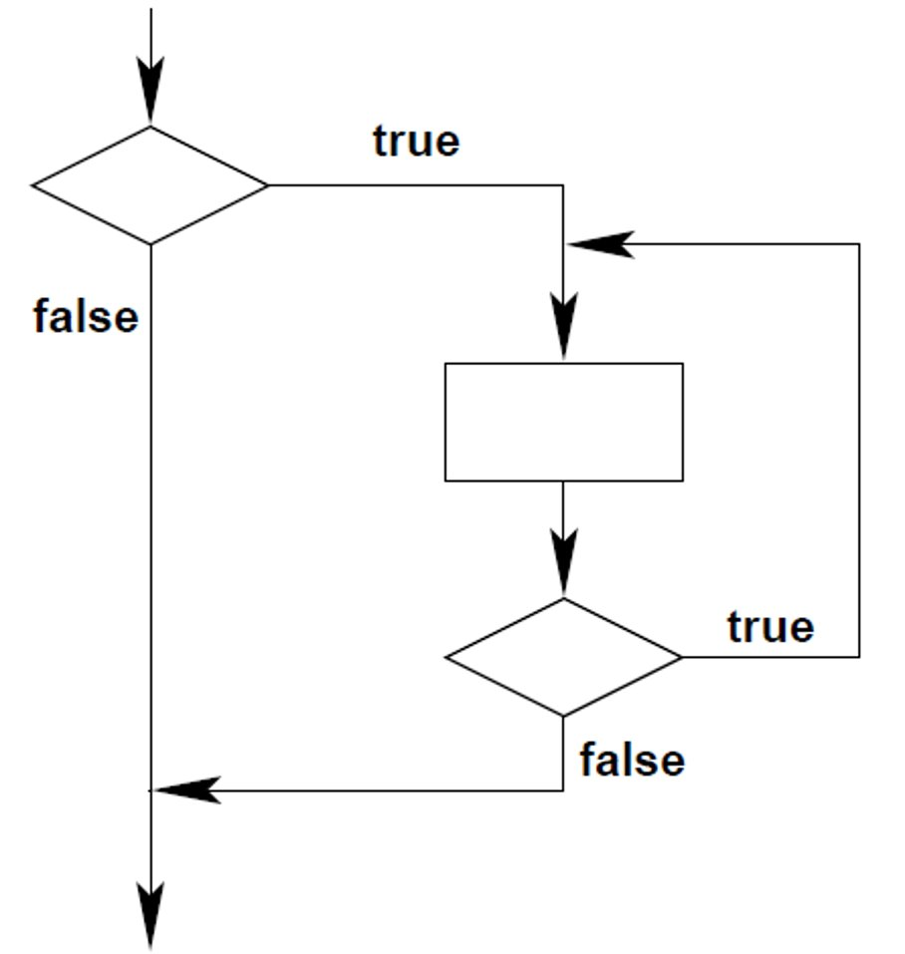
LOOPS FOR $100
This flow diagram is best described as which one of the following?
A. an if statement with a do-while loop nested inside
B. an if statement with a while loop nested inside
C. a do-while loop with an if statement nested inside
D. a while loop with a do-while loop nested inside
E. a while loop with an if statement nested inside

Slide 10
LOOPS FOR $100
This flow diagram is best described as which one of the following?
A. an if statement with a do-while loop nested inside
B. an if statement with a while loop nested inside
C. a do-while loop with an if statement nested inside
D. a while loop with a do-while loop nested inside
E. a while loop with an if statement nested inside

Slide 11
LOOPS FOR $200
Consider writing code that works as follows: the user enters a positive number, and then that many strings are read.
Which is the best kind of loop to use, and the correct reason for that choice?
A. a while loop because the code must read inputs until a condition is satisfied
B. a do-while loop so that both the positive number and the inputs can be read inside the loop
C. a do-while loop because at least one input must be read before looping
D. a for loop because the code must read inputs until a condition is satisfied
E. a for loop because the positive number tells how many times to loop

Slide 12
LOOPS FOR $200
Consider writing code that works as follows: the user enters a positive number, and then that many strings are read.
Which is the best kind of loop to use, and the correct reason for that choice?
A. a while loop because the code must read inputs until a condition is satisfied
B. a do-while loop so that both the positive number and the inputs can be read inside the loop
C. a do-while loop because at least one input must be read before looping
D. a for loop because the code must read inputs until a condition is satisfied
E. a for loop because the positive number tells how many times to loop

Slide 13
LOOPS FOR $300
What does the following code do?
double exp = 1;
for (int i = 1 ; i <= b ; i++)
exp = exp * a;
a) Compute a^{b}
b) Compute bª
c) Compute a*b
d) Compute b^{1/a}

Slide 14
LOOPS FOR $300
What does the following code do?
double exp = 1;
for (int i = 1 ; i <= b ; i++)
exp = exp * a;
a) Compute a^{b}
b) Compute bª
c) Compute a*b
d) Compute b^{1/a}

Slide 15
LOOPS FOR $400
Consider:
int a = 6;
int b = 12;
while(a < b) {
System.out.println(“In the loop”);
a+=2;
b-=2;
}
How many times is
“In the loop” printed?
a) 6
b) 4
c) 3
d) 2

Slide 16
LOOPS FOR $400
Consider:
int a = 6;
int b = 12;
while(a < b) {
System.out.println(“In the loop”);
a+=2;
b-=2;
}
How many times is
“In the loop” printed?
a) 6
b) 4
c) 3
d) 2

Slide 17
LOOPS FOR $500
Consider the following code fragment:
int x = 0
int y = 0;
while (x < 8) {
y = 3;
do {
System.out.print(’*’);
y--;
} while (x <= y););
x++;
}
How many stars are
printed when this code
executes?
A. 4
B. 8
C. 10
D. 11
E. 14

Slide 18
LOOPS FOR $500
Consider the following code fragment:
int x = 0
int y = 0;
while (x < 8) {
y = 3;
do {
System.out.print(’*’);
y--;
} while (x <= y););
x++;
}
How many stars are
printed when this code
executes?
A. 4
B. 8
C. 10
D. 11
E. 14

Slide 19
1D ARRAYS FOR $100
public static void main (String[] args) {
int arr1[] = {1, 2, 3};
int arr2[] = {1, 2, 3};
if (arr1 == arr2)
System.out.println("Same");
else
System.out.println("Not same");
}
What is the output of this code?
a) Same
b) Not same
c) Compile error
d) Runtime error

Slide 20
1D ARRAYS FOR $100
public static void main (String[] args) {
int arr1[] = {1, 2, 3};
int arr2[] = {1, 2, 3};
if (arr1 == arr2)
System.out.println("Same");
else
System.out.println("Not same");
}
What is the output of this code?
a) Same
b) Not same
c) Compile error
d) Runtime error

Slide 21
1D ARRAYS FOR $200
How can we complete the following code so that it returns true iff the int values
in array A are sorted in increasing order?
for (int k=0; k<A.length-1; k++) {
if (condition) return value 1;
}
return value 2;
​ | Condition​ | Value1​ | Value2​
A.​ | A[k] < A[k+1] ​ | True​ | False​
B.​ | A[k] > A[k+1] ​ | False​ | True​
C.​ | A[k] == A[k+1] ​ | True​ | False​
D.​ | A[k] == A[k+1] ​ | False​ | True​
E.​ | A[k] <= A[k+1] ​ | True​ | False​

Slide 22
1D ARRAYS FOR $200
How can we complete the following code so that it returns true iff the int values
in array A are sorted in increasing order?
for (int k=0; k<A.length-1; k++) {
if (condition) return value 1;
}
return value 2;
​ | Condition​ | Value1​ | Value2​
A.​ | A[k] < A[k+1] ​ | True​ | False​
B.​ | A[k] > A[k+1] ​ | False​ | True​
C.​ | A[k] == A[k+1] ​ | True​ | False​
D.​ | A[k] == A[k+1] ​ | False​ | True​
E.​ | A[k] <= A[k+1] ​ | True​ | False​

Slide 23
1D ARRAYS FOR $300
Consider:
public static void main(String args[]) {
int arr[2];
System.out.print(arr[0]);
System.out.print(arr[1]);
}
What is the output of this code?
a) 0 0
b) null null
c) Compile error
d) Runtime error

Slide 24
1D ARRAYS FOR $300
Consider:
public static void main(String args[]) {
int arr[2];
System.out.print(arr[0]);
System.out.print(arr[1]);
}
What is the output of this code?
a) 0 0
b) null null
c) Compile error
d) Runtime error

Slide 25
1D ARRAYS FOR $400
int[] B = new int[2*A.length];
int j = B.length-1;
for (int k=0; k<A.length; k++) {
B[k] = A[k];
B[j] = A[k];
j--;
}
If A looks like this: [ 1 2 3 4 ], what does B look like after the code above finishes?
A. [ 1 2 3 4 4 3 2 1]
B. [ 1 2 3 4 1 2 3 4 ]
C. [ 4 3 2 1 1 2 3 4 ]
D. [ 4 3 2 1 4 3 2 1 ]
E. [ 1 4 2 3 1 4 2 3 ]

Slide 26
1D ARRAYS FOR $400
int[] B = new int[2*A.length];
int j = B.length-1;
for (int k=0; k<A.length; k++) {
B[k] = A[k];
B[j] = A[k];
j--;
}
If A looks like this: [ 1 2 3 4 ], what does B look like after the code above finishes?
A. [ 1 2 3 4 4 3 2 1]
B. [ 1 2 3 4 1 2 3 4 ]
C. [ 4 3 2 1 1 2 3 4 ]
D. [ 4 3 2 1 4 3 2 1 ]
E. [ 1 4 2 3 1 4 2 3 ]

Slide 27
1D ARRAYS FOR $500
When does this code return true?
for (int j=0; j<A.length - 1; j++) {
for (int k=j+1; k<A.length; k++) {
if (A[j] == A[k]) {
return false;
}
}
}
return true;
A. when the values in A are in sorted order, small to large
B. when the values in A are in sorted order, large to small
C. when no value occurs more than once in A
D. when some value occurs more than once in A
E. when all values in A are the same

Slide 28
1D ARRAYS FOR $500
When does this code return true?
for (int j=0; j<A.length - 1; j++) {
for (int k=j+1; k<A.length; k++) {
if (A[j] == A[k]) {
return false;
}
}
}
return true;
A. when the values in A are in sorted order, small to large
B. when the values in A are in sorted order, large to small
C. when no value occurs more than once in A
D. when some value occurs more than once in A
E. when all values in A are the same

Slide 29
2D ARRAYS FOR $100
Which of the following 2D array initializations is correct?
A. float[2][2] b = {0.1,0.2,0.3,0.4};
B. int[][] a = {{1,2},{3,4}};
C. int[2][] a = {{1,2},{3,4}};
D. float[2][2] a = {0};
E. float[][] f = new float[][6];

Slide 30
2D ARRAYS FOR $100
Which of the following 2D array initializations is correct?
A. float[2][2] b = {0.1,0.2,0.3,0.4};
B. int[][] a = {{1,2},{3,4}};
C. int[2][] a = {{1,2},{3,4}};
D. float[2][2] a = {0};
E. float[][] f = new float[][6];

Slide 31
2D ARRAYS FOR $200
Consider the arr object declaration below.
double arr[ ][ ];
arr = new double[4][5];
int r; // row index on arr
int c; // column index of arr
Which of the following statements stores the column length of arr?
a) arr.length
b) arr.rowLength
c) arr[r].length
d) arr[c].length

Slide 32
2D ARRAYS FOR $200
Consider the arr object declaration below.
double arr[ ][ ];
arr = new double[4][5];
int r; // row index on arr
int c; // column index of arr
Which of the following statements stores the column length of arr?
a) arr.length
b) arr.rowLength
c) arr[r].length
d) arr[c].length

Slide 33
2D ARRAYS FOR $300
Fill in the blanks to print out the following 2D array:
public static void main(String[] args) {
int[][] a = {{1,4,6},{2,5},{3}};
for(int i = 0; i < expression 1; i++)
{
for(int j= 0; j < expression 2; j++)
{
System.out.println(expression 3);
}
}
}
Which of the following should replace
expression 1, expression 2, and expression 3?
A. a.length; a[0].length; a[j][i]
B. a.length; a[i].length; a[i][j]
C. a[0].length; a[i].length; a[i][j]
D. a[0].length; a.length; new a[i][j]

Slide 34
2D ARRAYS FOR $300
Fill in the blanks to print out the following 2D array:
public static void main(String[] args) {
int[][] a = {{1,4,6},{2,5},{3}};
for(int i = 0; i < expression 1; i++)
{
for(int j= 0; j < expression 2; j++)
{
System.out.println(expression 3);
}
}
}
Which of the following should replace
expression 1, expression 2, and expression 3?
A. a.length; a[0].length; a[j][i]
B. a.length; a[i].length; a[i][j]
C. a[0].length; a[i].length; a[i][j]
D. a[0].length; a.length; new a[i][j]

Slide 35
2D ARRAYS FOR $400
The following method takes a 2D array a, and returns a new 1D array b
that is the sum of each row. (e.g., a = {{1, 2, 3}, {4 ,5 ,6}} then b = {6, 15}
public int[] sumRows(int[][] a){
int[] b = new int[expression 1];
for (int r = 0; r < a.length ; r++){
int total = 0;
for (int c = 0; c < a[r].length; c++){
expression 2;
}
expression 3;
}
return b;
}
Which of the following should replace expression 1,
Expression 2, and expression 3?
A. a.length total += a[r] b[r] += total
B. a.length total += a[r][c] b[r] = total
C. a total += a[r] b[r] += total
D. a total += a[r][c] b[r] = total

Slide 36
2D ARRAYS FOR $400
The following method takes a 2D array a, and returns a new 1D array b
that is the sum of each row. (e.g., a = {{1, 2, 3}, {4 ,5 ,6}} then b = {6, 15}
public int[] sumRows(int[][] a){
int[] b = new int[expression 1];
for (int r = 0; r < a.length ; r++){
int total = 0;
for (int c = 0; c < a[r].length; c++){
expression 2;
}
expression 3;
}
return b;
}
Which of the following should replace expression 1,
Expression 2, and expression 3?
A. a.length total += a[r] b[r] += total
B. a.length total += a[r][c] b[r] = total
C. a total += a[r] b[r] += total
D. a total += a[r][c] b[r] = total

Slide 37
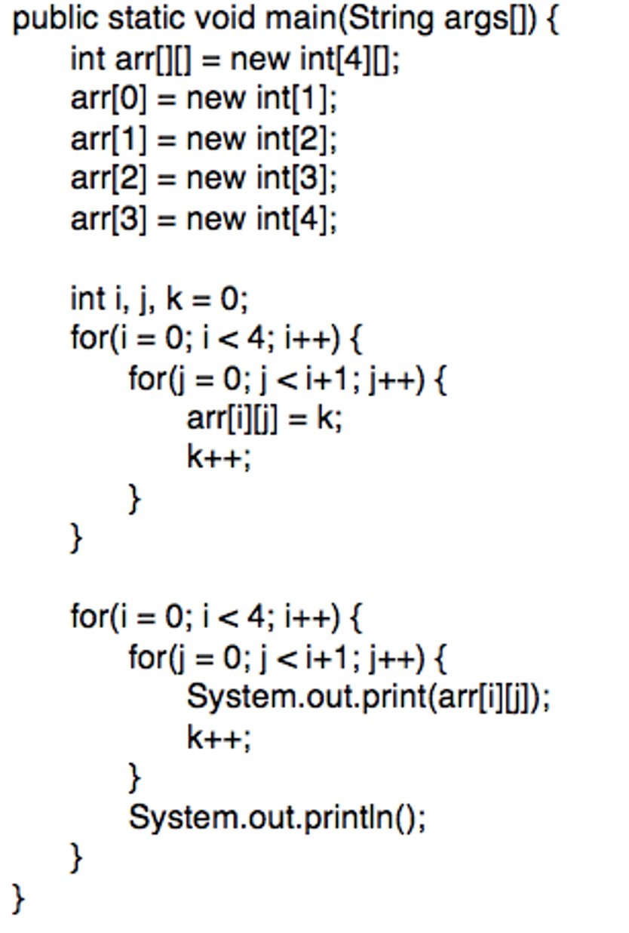
2D ARRAYS FOR $500
What is the output of this code?
a) 0123456789
b) 9
87
654
3210
c) Compile Error
d) 0
12
345
6789

Slide 38
2D ARRAYS FOR $500
What is the output of this code?
a) 0123456789
b) 9
87
654
3210
c) Compile Error
d) 0
12
345
6789

Slide 39
ARRAYLISTS FOR $100
ArrayList<String> list = new ArrayList<String>();
list.add(“words”);
list.add(0, “are”);
list.add(“not”);
list.add(0, “in”);
list.add(“order”);
What are the contents of this ArrayList?
A. {“in”, “are”, “words”, “not”, “order”}
B. {“words”, “are”, “not”, “in”, “order”}
C. {“are”, “not”, “order”, “words”, “in”}
D. {“not”, “in”, “order”, “are”, “words”}
E. {“words”, “in”, “order”, “are”, “not”}

Slide 40
ARRAYLISTS FOR $100
ArrayList<String> list = new ArrayList<String>();
list.add(“words”);
list.add(0, “are”);
list.add(“not”);
list.add(0, “in”);
list.add(“order”);
What are the contents of this ArrayList?
A. {“in”, “are”, “words”, “not”, “order”}
B. {“words”, “are”, “not”, “in”, “order”}
C. {“are”, “not”, “order”, “words”, “in”}
D. {“not”, “in”, “order”, “are”, “words”}
E. {“words”, “in”, “order”, “are”, “not”}

Slide 41
ARRAYLISTS FOR $200
Assume the ArrayList myList contains {5,3,1}.
myList.add(6);
myList.add(0,4);
myList.remove(1);
What will myList contain after this code is executed?
a) [5,3,1,6]
b) [4,3,1,6]
c) [4,3,6]
d) [4,5,3,6]

Slide 42
ARRAYLISTS FOR $200
Assume the ArrayList myList contains {5,3,1}.
myList.add(6);
myList.add(0,4);
myList.remove(1);
What will myList contain after this code is executed?
a) [5,3,1,6]
b) [4,3,1,6]
c) [4,3,6]
d) [4,5,3,6]

Slide 43
ARRAYLISTS FOR $300
Assume ArrayList a has contents
{2,4,4,3,9,2,12,2};
int total = 0;
for(int i = 0; i < a.size(); i+=2){
int temp = Math.pow(a.get(i), a.get(i+1));
if (a.get(i+1)== 2) {
temp = Math.pow(temp, .5);
}
total += temp;
}
System.out.println(“The total is: ” + total);
What is output by this ArrayList?
A. 2
B. 101
C. 38
D. 204863
E. 42

Slide 44
ARRAYLISTS FOR $300
Assume ArrayList a has contents
{2,4,4,3,9,2,12,2};
int total = 0;
for(int i = 0; i < a.size(); i+=2){
int temp = Math.pow(a.get(i), a.get(i+1));
if (a.get(i+1)== 2) {
temp = Math.pow(temp, .5);
}
total += temp;
}
System.out.println(“The total is: ” + total);
What is output by this ArrayList?
A. 2
B. 101
C. 38
D. 204863
E. 42

Slide 45
ARRAYLISTS FOR $400
Assume ArrayList nums has contents
{0, 0, 4, 2, 5, 0, 3, 0}.
public void numQuest() {
int k = 0;
Integer zero = new Integer(0);
while (k < nums.size()) {
if (nums.get(k).equals(zero)) {
nums.remove(k);
}
k++;
}
}
What will nums contain after numQuest() is executed?
a) [0,0,4,2,5,0,3,0]
b) [0,0,0,0,4,2,5,3]
c) [0,4,2,5,3]
d) [4,2,5,3]

Slide 46
ARRAYLISTS FOR $400
Assume ArrayList nums has contents
{0, 0, 4, 2, 5, 0, 3, 0}.
public void numQuest() {
int k = 0;
Integer zero = new Integer(0);
while (k < nums.size()) {
if (nums.get(k).equals(zero)) {
nums.remove(k);
}
k++;
}
}
What will nums contain after numQuest() is executed?
a) [0,0,4,2,5,0,3,0]
b) [0,0,0,0,4,2,5,3]
c) [0,4,2,5,3]
d) [4,2,5,3]

Slide 47
ARRAYLISTS FOR $500
Choose the code below that will Output {2,3,4,5,1} after the code fragment is complete:
ArrayList<Integer> line = new ArrayList<Integer>();
// Assume that line contains {1, 2, 3, 4, 5}
int temp =line.get(0);
for(Spot1; Spot2 ; Spot3){
Spot4 ;
}
line.set(line.size()-1, temp);
​ | Spot1​ | Spot2​ | Spot3​ | Spot4​
A​ | int i =line.size()-1 ​ | i > 0 ​ | i--​ | line.set(i-1,line.get(i))​
B​ | int i =0 ​ | i <line.size()-1​ | i++​ | line.set(i,line.get(i+1)) ​
C​ | int i =0 ​ | i <line.size()-2​ | i++​ | line.set(i,line.get(i+1))​
D​ | int i =line.size()-1 ​ | i >= 0 ​ | i--​ | line.set(i-1,line.get(i))​
E​ | int i =line.size()-2​ | i >= 0 ​ | i--​ | line.set(i,line.get(i+1)) ​

Slide 48
ARRAYLISTS FOR $500
Choose the code below that will Output {2,3,4,5,1} after the code fragment is complete:
ArrayList<Integer> line = new ArrayList<Integer>();
// Assume that line contains {1, 2, 3, 4, 5}
int temp =line.get(0);
for(Spot1; Spot2 ; Spot3){
Spot4 ;
}
line.set(line.size()-1, temp);
​ | Spot1​ | Spot2​ | Spot3​ | Spot4​
A​ | int i =line.size()-1 ​ | i > 0 ​ | i--​ | line.set(i-1,line.get(i))​
B​ | int i =0 ​ | i <line.size()-1​ | i++​ | line.set(i,line.get(i+1)) ​
C​ | int i =0 ​ | i <line.size()-2​ | i++​ | line.set(i,line.get(i+1))​
D​ | int i =line.size()-1 ​ | i >= 0 ​ | i--​ | line.set(i-1,line.get(i))​
E​ | int i =line.size()-2​ | i >= 0 ​ | i--​ | line.set(i,line.get(i+1)) ​

Slide 49
EXCEPTIONS FOR $100
The class at the top of the exception classes hierarchy is called _____ ?
a) Error
b) Throwable
c) Hierarchy
d) Runtime

Slide 50
EXCEPTIONS FOR $100
The class at the top of the exception classes hierarchy is called _____ ?
a) Error
b) Throwable
c) Hierarchy
d) Runtime

Slide 51
EXCEPTIONS FOR $200
import java.util.ArrayList;
public class ExceptionExample{
public static void main (String args[]) {
ArrayList<Integer> arr = null;
System.out.println( arr.size() );
}
}
What happens when you execute the code?
A. It does not compile.
B. It prints out 0 at the console.
C. It prints out 0 then throw a NullPointerException.
D. It throws a NullPointerException but does not print out anything.
E. It throws a NullPointerException and then print out 0.

Slide 52
EXCEPTIONS FOR $200
import java.util.ArrayList;
public class ExceptionExample{
public static void main (String args[]) {
ArrayList<Integer> arr = null;
System.out.println( arr.size() );
}
}
What happens when you execute the code?
A. It does not compile.
B. It prints out 0 at the console.
C. It prints out 0 then throw a NullPointerException.
D. It throws a NullPointerException but does not print out anything.
E. It throws a NullPointerException and then print out 0.

Slide 53
EXCEPTIONS FOR $300
try {
//code that causes IO Exception
}
catch (IOException Ex) {
System.out.println(“IO Exception”);
}
catch (NullPointerException Ex) {
System.out.println(“Null Pointer Exception”);
}
finally {
System.out.println(“Finally”);
}
What is printed out?
a. IO Exception
Null Pointer Exception
Finally
b. IO Exception
Null Pointer Exception
c. IO Exception
Finally
d. IO Exception

Slide 54
EXCEPTIONS FOR $300
try {
//code that causes IO Exception
}
catch (IOException Ex) {
System.out.println(“IO Exception”);
}
catch (NullPointerException Ex) {
System.out.println(“Null Pointer Exception”);
}
finally {
System.out.println(“Finally”);
}
What is printed out?
a. IO Exception
Null Pointer Exception
Finally
b. IO Exception
Null Pointer Exception
c. IO Exception
Finally
d. IO Exception

Slide 55
EXCEPTIONS FOR $400
try {
int a, b;
b = 0;
a = 5 / b;
System.out.print("A");
}
catch(ArithmeticException e)
{
System.out.print("B");
}
What is printed out?
a) A
b) B
c) Runtime Error
d) Nothing

Slide 56
EXCEPTIONS FOR $400
try {
int a, b;
b = 0;
a = 5 / b;
System.out.print("A");
}
catch(ArithmeticException e)
{
System.out.print("B");
}
What is printed out?
a) A
b) B
c) Runtime Error
d) Nothing

Slide 57
EXCEPTIONS FOR $500
Which ones are checked Exceptions?
A. IOException
B. InputMismatchException
C. ArrayIndexOutOfBoundsException
D. IndexOutOfBoundsException
E. NullPointerException
F. ArithmeticException

Slide 58
EXCEPTIONS FOR $500
Which ones are checked Exceptions?
A. IOException
B. InputMismatchException
C. ArrayIndexOutOfBoundsException
D. IndexOutOfBoundsException
E. NullPointerException
F. ArithmeticException

Slide 59
POTPOURRI FOR $100
After line 7 executes for the first time, what does the call stack look like?
1. public static in methodC(){
2. int x = 7;
3. return x;
4. }
5. public static int methodB(){
6. int x = methodC();
7. x = 2;
8. return x;
9. }
10. public static int methodA(){
11. int x = methodB();
12. x = 6;
13. return x;
14. }
15. public static void main(String[] args){
16. int x;
17. x = methodA();
18. }
A. B.
D.
C.
C
B
7
2
B
A
2
/
A
main
6
0
main
6
B
2
B
A
2
6
main
main
0
6

Slide 60
POTPOURRI FOR $100
After line 7 executes for the first time, what does the call stack look like?
1. public static in methodC(){
2. int x = 7;
3. return x;
4. }
5. public static int methodB(){
6. int x = methodC();
7. x = 2;
8. return x;
9. }
10. public static int methodA(){
11. int x = methodB();
12. x = 6;
13. return x;
14. }
15. public static void main(String[] args){
16. int x;
17. x = methodA();
18. }
A. B.
D.
C.
C
B
7
2
B
A
2
/
A
main
6
0
main
6
B
2
B
A
2
6
main
main
0
6

Slide 61
POTPOURRI FOR $200
1. public static void main(String args[]){ 2. int[] myAr = new int[5]; 3. method(myAr); 4. myAr[0] = 5; 5. }
6. public static void method(int[] anAr){ 7. for(int i = 0; i<anAr.length; i++){ 8. anAr[i]++; 9. } 10. }
What statement about the above code is FALSE?
A. anAr is an alias to myAr B. When myAr is changed in line 4, anAr is also changed. C. When anAr is changed in line 8, myAr is also changed. D. anAr only exists while method is on the call stack.

Slide 62
POTPOURRI FOR $200
1. public static void main(String args[]){ 2. int[] myAr = new int[5]; 3. method(myAr); 4. myAr[0] = 5; 5. }
6. public static void method(int[] anAr){ 7. for(int i = 0; i<anAr.length; i++){ 8. anAr[i]++; 9. } 10. }
What statement about the above code is FALSE?
A. anAr is an alias to myAr B. When myAr is changed in line 4, anAr is also changed. C. When anAr is changed in line 8, myAr is also changed. D. anAr only exists while method is on the call stack.

Slide 63
POTPOURRI FOR $300
Consider the following 3D array:
String[][][] arr = new String[3][4][2];
What is the maximum amount of elements that this array can hold?
a) 3
b) 4
c) 24
d) 100

Slide 64
POTPOURRI FOR $300
Consider the following 3D array:
String[][][] arr = new String[3][4][2];
What is the maximum amount of elements that this array can hold?
a) 3
b) 4
c) 24
d) 100

Slide 65
POTPOURRI FOR $400
Consider the following code fragment:
public static void main(String[] args){​ int[] myArray = new int[4];​ int x = 2;​ ​ mystery(myArray, x);​ System.out.print(x + “ ” + myArray);​ ​ }​
public static void mystery(int[] ar, int y){​ y++;​ for(int i = 0; i<ar.length; i++){​ ar[i] = y;​ }​ System.out.print(y + “ ” + ar);​ }
What is printed after the code is executed, assuming we've overwritten the toString() to print the array's contents? A. 2 [0,0,0,0] 2 [3,3,3,3] B. 2 [3,3,3,3] 2 [0,0,0,0] C. 3 [3,3,3,3] 2 [3,3,3,3] D. 3 [3,3,3,3] 3 [3,3,3,3]

Slide 66
POTPOURRI FOR $400
Consider the following code fragment:
public static void main(String[] args){​ int[] myArray = new int[4];​ int x = 2;​ ​ mystery(myArray, x);​ System.out.print(x + “ ” + myArray);​ ​ }​
public static void mystery(int[] ar, int y){​ y++;​ for(int i = 0; i<ar.length; i++){​ ar[i] = y;​ }​ System.out.print(y + “ ” + ar);​ }
What is printed after the code is executed, assuming we've overwritten the toString() to print the array's contents? A. 2 [0,0,0,0] 2 [3,3,3,3] B. 2 [3,3,3,3] 2 [0,0,0,0] C. 3 [3,3,3,3] 2 [3,3,3,3] D. 3 [3,3,3,3] 3 [3,3,3,3]

Slide 67
FINAL JEOPARODY
Consider the following code:
public class Swap {
public static void swap(int x, int y) {
int temp = x;
x = y;
y = temp;
System.out.print(“x = “ + x);
System.out.print(“y = “ + y);
}
public static void main(String[] args) {
int x = 10;
int y = 20;
swap(x,y);
System.out.print(“x = “ + x);
System.out.print(“y = “ + y);
}
}
What will the output be?
a) 20 20 10 10
b) 10 10 20 20
c) 20 10 10 20
d) 10 20 20 10

Slide 68
FINAL JEOPARODY
Consider the following code:
public class Swap {
public static void swap(int x, int y) {
int temp = x;
x = y;
y = temp;
System.out.print(“x = “ + x);
System.out.print(“y = “ + y);
}
public static void main(String[] args) {
int x = 10;
int y = 20;
swap(x,y);
System.out.print(“x = “ + x);
System.out.print(“y = “ + y);
}
}
What will the output be?
a) 20 20 10 10
b) 10 10 20 20
c) 20 10 10 20
d) 10 20 20 10

